Slide 1



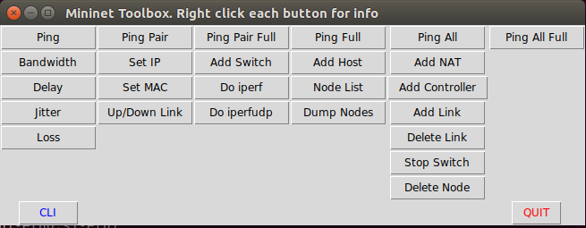
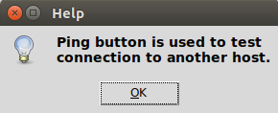
Mininet Usage As Software-Defined Networking Learning Media
Rifkiansyah Meidian C. - 13511084
Informatics
Introduction
Networking had reached a point where a lot of networks need to be tested with minimal usage of resources available. Software-Defined Network is a way for network prototyping with minimal resource usage.
Learning Software-Defined Network is a challenge of its own. There are many tutorial that a newcomer can look for, but with each still came challenges.
Mininet is a system for rapid prototyping using minimal resources by utilizing lightweight virtualization of Linux kernel.
Figure 1, Topology Menu
Tutorial menu can be accessed from the topology menu. The tutorial menu can be filled with study cases pertaining different concepts of Software-Defined Networking and usage of Mininet and relevant tools such as Open vSwitch ovs-ofctl.
Figure 2, Tutorial Menu
Tutorial Menu can be adjusted by the tutor to show learning instances and steps.
Toolbox Menu lists available Mininet functions implemented by Mininet API. As such, functions initially needing to be used with Python script inside Mininet natural command-line interface can be used directly.
Figure 3, Mininet Toolbox.
Aside of the main menu, a help is also available when the user right-clicks a topology or a function.
Figure 4, Help Menu.
The help menu allows for a quick look of a function, helping in learning.
On all four categories, Mininet using interface tops the usage of Mininet without interface.
The graphical user interface greatly aids in learning, where the intuitive design and feedbacks help subjects to learn easier compared to natural usage of Mininet from tutorials.
The help menu also helps understanding functions that is available on Mininet with minimal difficulty, compared to natural Mininet usage where the help menu is complicated.
The second study case tests the functionality of Mininet API interface when used in conjunction with other Software-Defined Network tool, ovs-ofctl.
The result is that ovs-ofctl can be used in conjunction with Mininet API interface. However, further integration will be needed to achieve optimal network management simulation with Mininet API interface.
Aim
To create an interface to ease Software-Defined Network learning utilizing Mininet API
Analysis
Software-Defined Networking tools are not easy for newcomers to learn. Most tutorial required complex setup for users to start learning.
To ease learning, an interface is more effective than command-line. Mininet API allows for implementation of Mininet using Python.
For the interface itself, Python default GUI implementation using Tkinter is the easiest to use. It has the flexibility to implement a simple interface for Mininet usage.
Evaluation
The interface improves Mininet learning rate, helping newcomers to Software-Defined Network to learn more efficiently.
Improvement can still be made by integrating more tools into the Mininet interface, bringing the simulation closer to actual network management instead of only testing topologies.
Implementation
The implementation consists of three main interfaces: Topology Menu; Tutorial Menu; and Toolbox Menu
Topology menu consists of five topologies: Minimal topology; Linear topology; Tree topology; Torus topology; and Reversed Single Switch Topology.
Testing
Two types of case study are conducted. The first test conducted with IT specialists as testers of the interface.
At the first test, four main categories are tested: Ease of Use, Functional Clarity, Ease of Learning, and Help Menu.
Acknowledgement
Thank you for:
Ir. Afwarman Manaf. M.Sc., Ph.D. as the guiding lecturer.
Achmad Imam Kistijantoro ST, M.Sc., Ph.D. for the topic.

